Slide 1
Introduction to Generative AI
Generated by Groq AI

Slide 2
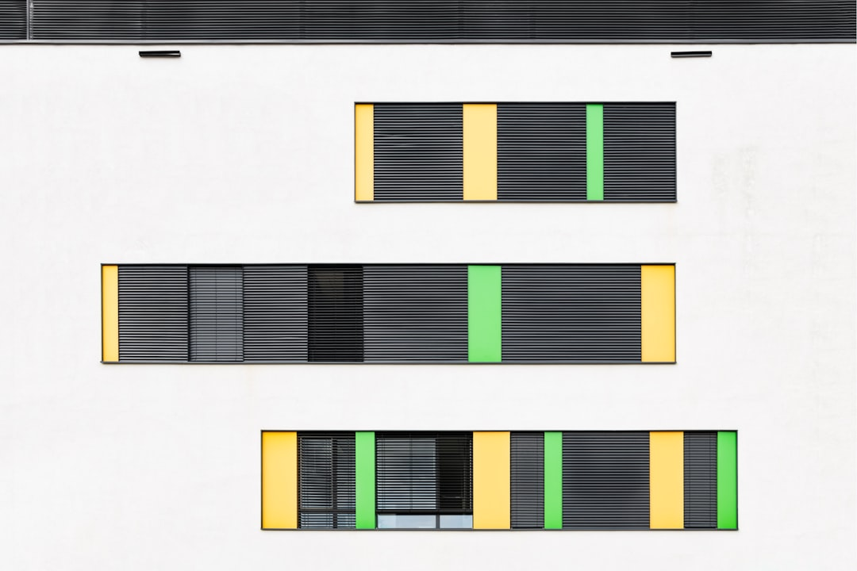
Types of Generative AI Models
• Generative Adversarial Networks (GANs): consist of two neural networks that work together to generate new content
• Variational Autoencoders (VAEs): use a probabilistic approach to generate new content by learning a continuous and structured representation of the input data
• Transformers: a type of neural network architecture that is particularly well-suited for natural language processing tasks, such as language translation and text generation

Slide 3
AI Agents and Their Applications
• AI agents are computer programs that use artificial intelligence to perform tasks autonomously, such as playing games, controlling robots, or making decisions
• AI agents can be used in a wide range of applications, including customer service, healthcare, and finance
• Examples of AI agents include chatbots, virtual assistants, and autonomous vehicles

Slide 4
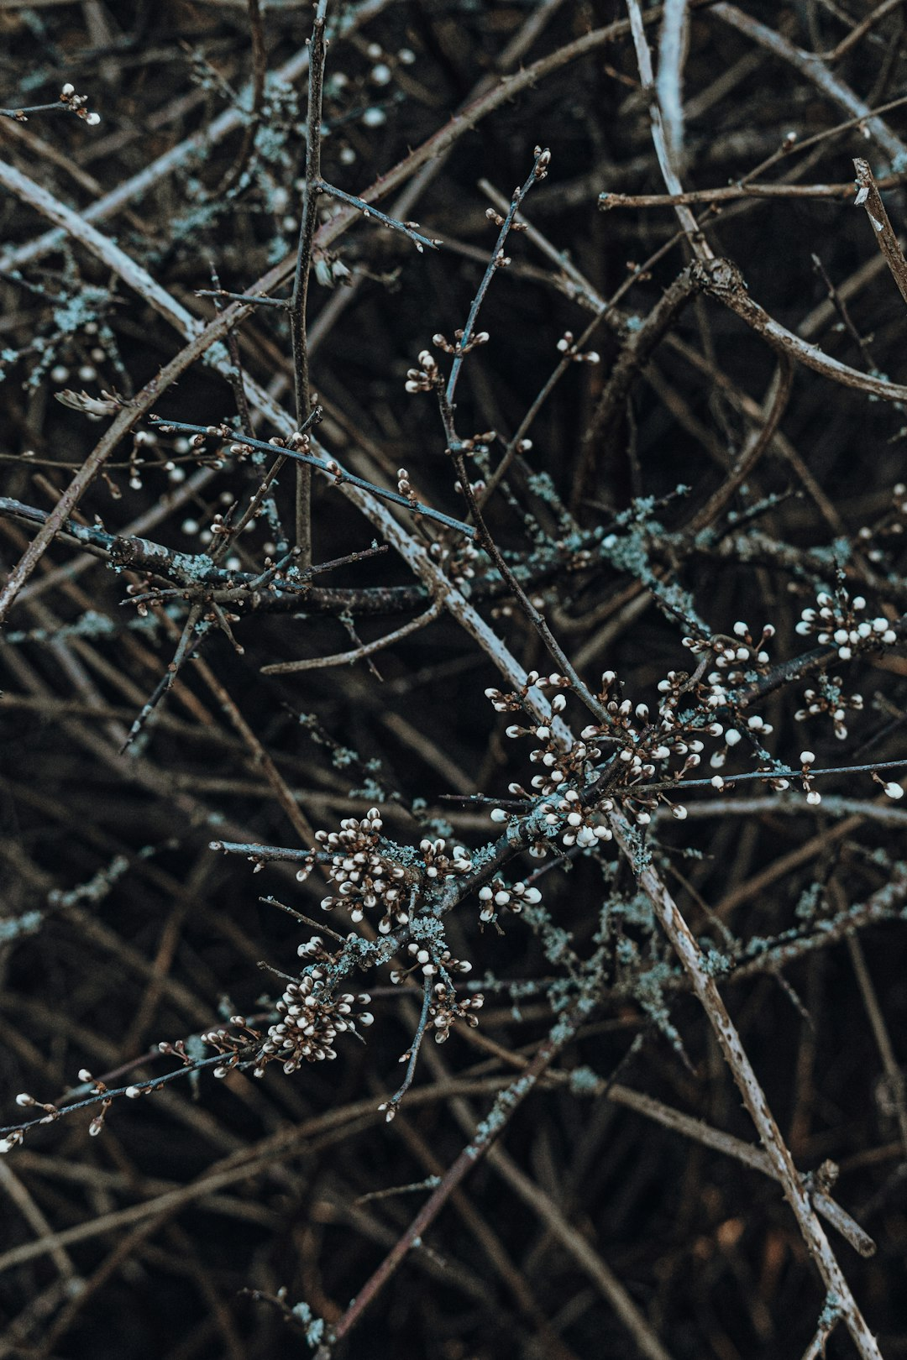
Benefits and Challenges of Generative AI and AI Agents
• Benefits: increased efficiency, improved accuracy, and enhanced creativity
• Challenges: potential job displacement, bias and fairness issues, and the need for transparent and explainable decision-making
• Future directions: developing more advanced and specialized AI models, improving human-AI collaboration, and addressing the ethical and societal implications of AI

Slide 5
Conclusion: The Future of Generative AI and AI Agents
• Generative AI and AI agents have the potential to transform numerous industries and aspects of our lives
• However, it is crucial to address the challenges and concerns associated with these technologies, such as bias, fairness, and transparency
• By working together to develop and apply these technologies responsibly, we can unlock their full potential and create a brighter future for all

